Slide 1
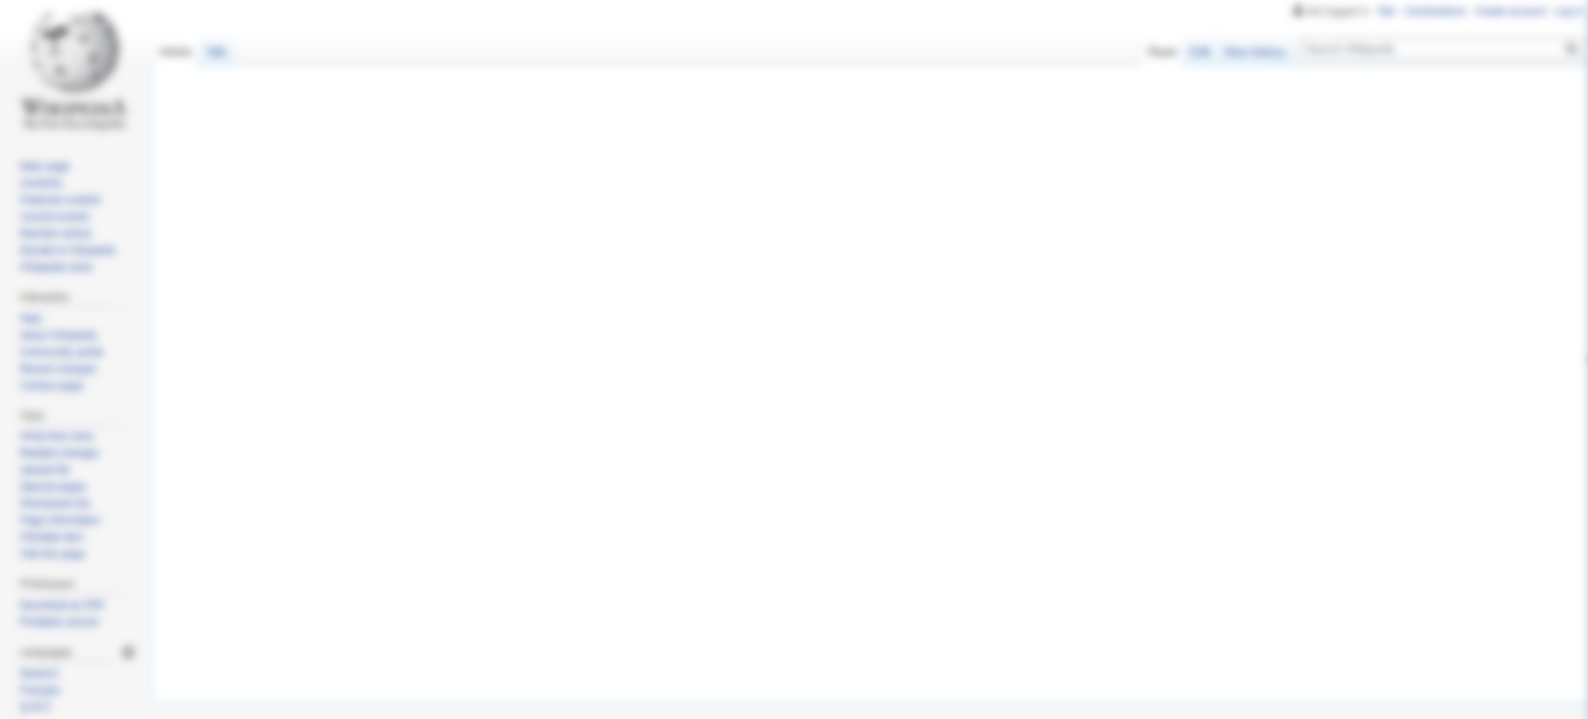


WikiPlugin
A smart lens for viewing the world’s knowledge
Team Members:
Matt Canute, Young-Min Kim, Donggu Lee, Suraj Swaroop, Adriena Wong
Notes:
Hi.
We started this project on the idea of making an incremental improvement to Wikipedia in the form of a plugin. Because it’s a great resource, but I’m sure we’ve all had the frustration of stumbling on a technical wikipedia article that’s completely illegible to us if it’s outside our domain experience, and it’s hard to know where to begin.
Some efforts by the wikipedia community have been helpful, such as the Simple Wikipedia initiative, where they make an equivalent article if you type (simple) in the URL. But as of today, only 2.5% articles have the equivalent simple article.
------------------
Hi. “Can wikipedia be better?”
I think we’re all getting tired of hearing the cliche euphoria of “oh all the world’s knowledge is in your pocket”
--- yes but most of the hard subjects articles are completely illegible to an outsider.
Some articles can often be overwhelming, with a seemingly endless chain of sub-topics to understand beforehand.
We can’t solve that necessarily.
BUT, wouldn’t it be nice to know roughly how much time you’d need in order to understand an article’s main points and concepts? Wouldn’t it be nice to know the minimum number of related articles you’d need to read first to understand this one?
32 sec
Innovation (how novel the project idea is)
Potential Impact (includes scientific, economic, and social aspects)
Quality of Implementation (includes professional software design, documentation, and ease of use)

Slide 2
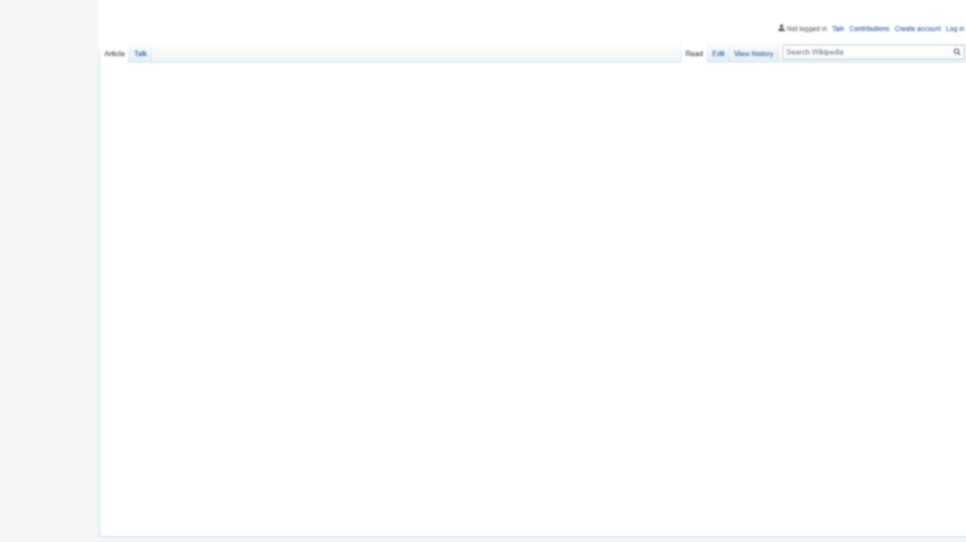
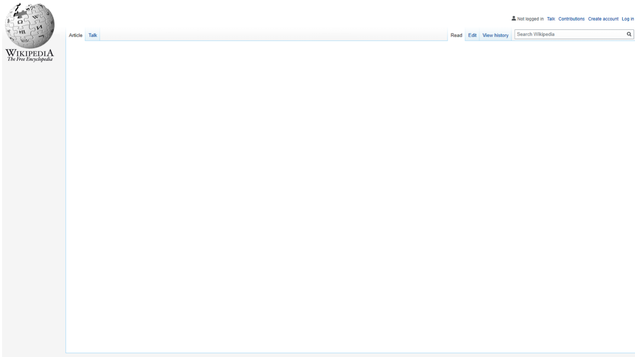
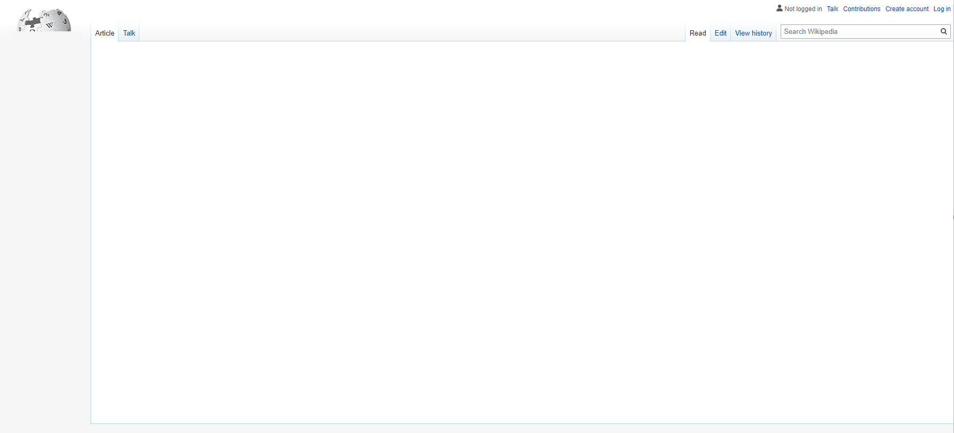

What are we trying to do?
Goal
Datasets
To enhance the Simple Wikipedia priority
Workflow
Model
Results
Chrome
Plugin
Website
Summary
Notes:
Some good efforts to improve the legibility of difficult articles with overly technical terms or field-specific jargon
So it would be interesting to have a bounty system based on the demand of the article, and the expected difficulty.
4 sec
We hope that this project will be able to benefit two stakeholders: users of Wikipedia as well as Wikimedia itself.
Could potentially enhance Simple Wikipedia
Improve read time estimates for complicated topics
Highlight the important related links on an article
Contrasting article similarity approaches can determine impactful cross-disciplinary collaboration potential

Slide 3
What are we trying to do?
Goal
Datasets
To enhance the Simple Wikipedia priority
Highlight the important related links on an article
Workflow
Model
Results
Chrome
Plugin
Website
Summary
Notes:
We also imagined a way to highlight the important links on each article like a heatmap,
3 secs
We hope that this project will be able to benefit two stakeholders: users of Wikipedia as well as Wikimedia itself.
Could potentially enhance Simple Wikipedia
Improve read time estimates for complicated topics
Highlight the important related links on an article
Contrasting article similarity approaches can determine impactful cross-disciplinary collaboration potential

Slide 4
What are we trying to do?
Goal
Datasets
To enhance the Simple Wikipedia priority
Highlight the important related links on an article
Find similar articles from the same field, or from other disciplines -- for context
Workflow
Model
Results
Chrome
Plugin
Website
Summary
Notes:
and a way to find similar articles not already linked within the same page, but would nonetheless contain very important context that the article might expect us to already understand
5 secs
We hope that this project will be able to benefit two stakeholders: users of Wikipedia as well as Wikimedia itself.
Could potentially enhance Simple Wikipedia
Improve read time estimates for complicated topics
Highlight the important related links on an article
Contrasting article similarity approaches can determine impactful cross-disciplinary collaboration potential

Slide 5
What are we trying to do?
Goal
Datasets
To enhance the Simple Wikipedia priority
Highlight the important related links on an article
Find similar articles from the same field, or from other disciplines -- for context
Improve read time estimates for complicated topics
Workflow
Model
Results
Chrome
Plugin
Website
Summary
Notes:
and a way to know the expected amount of time to read the whole page, based on the number of words, similar to medium articles (rising tone), but not just taking the number of words into account -- but also the difficulty
5 secs
We hope that this project will be able to benefit two stakeholders: users of Wikipedia as well as Wikimedia itself.
Could potentially enhance Simple Wikipedia
Improve read time estimates for complicated topics
Highlight the important related links on an article
Contrasting article similarity approaches can determine impactful cross-disciplinary collaboration potential

Slide 6


Our Goal
What are we trying to understand?
Goal
Datasets
1
2
Workflow
Model
Can we deploy our model into a user’s browser while they are reading Wikipedia?
Results
What makes an article difficult?
Chrome
Plugin
Website
Summary
Notes:
So you’ll notice underlying all of this, such as the priority score and read time estimates, we need to solve two fundamental problems.
We need to figure out if there are underlying statistical patterns in an article to define whether it would be difficult to understand its concepts.
Given that difficulty model, how can we embed that information in a useful way to a reader’s browser?
13 sec

Slide 7

Datasets / API
Goal
Datasets
Workflow
Wikipedia Dataset
Model
Results
Article Text
Clickstream Text
Wikipedia Data
Chrome
Plugin
Website
Summary
Millions of text for each article
Monthly snapshot
33 million rows each month
Wikipedia API
Notes:
To date we’ve seen people experiment with Wikipedia particularly for its rich graphical analysis potential, OR particularly for its rich text data, not both
What if the graphical information, like the typical length to reach an article, was a useful predictor of how much foundational knowledge was necessary? What if the term frequency and inverse document frequency could mechanically discover rare jargon words as another predictive feature? Could we use topic modelling to figure out when an article is simply describing a famous person’s life?
30 sec

Slide 8




Workflow
Goal
Data Pipeline
Jenkins Job Lists
Datasets
Docker + Jenkins
(Master-Slave Design)
Data Download
Workflow
1
Model
Results
Data Preprocessing
2
Chrome
Plugin
Text Metric Calculations
Website
3
Summary
Jenkins Server
Cached Complexity Model
4
Upload dataset to MySQL database
5
Continuous Integration
Continuous Delivery (CI/CD)
6
Merge files for Chrome Extension
Notes:
We created a script in Jenkins/Docker that is to be run monthly with any new Wikimedia datasets. This downloads the datasets on a monthly basis, cleans the text, calculates graphical metrics and word vector centroids, topic distributions, other metrics such as the fleisch readability score, loads our cached text model, scores it into a database for our web application to use, and outputs files for our chrome extension.
15 sec

Slide 9
‘Difficulty’ Model
1
2
3
Goal
Give 'Difficulty' Score
Datasets
Sampling
Read Article
Workflow
Model
300 articles
from Wikipedia
up to 2 minutes
based on a 3-point scale
Results
Chrome
Plugin
a | Easy | The article is completely easy to understand, and I could write a summary of the overall concept in a few sentences or less.
b | Normal | I wasn't able to finish the article within 2 minutes, and I think I could understand it. But I'd need to click some related links, and/or spend more time to understand it.
c | Complicated | This article is complicated, and probably even after spending another 20-30 minutes on it, and/or related links, I still wouldn't be able to confidently write a summary about it.
Website
Summary
Notes:
In order to build out our model, we randomly sampled 300 articles and manually labelled each of them based on if they were easy, or were they normal or complicated to understand? (in the interest of time, let’s get back to this to understand our survey design in more detail in the form of a question please)
33 sec

Slide 10
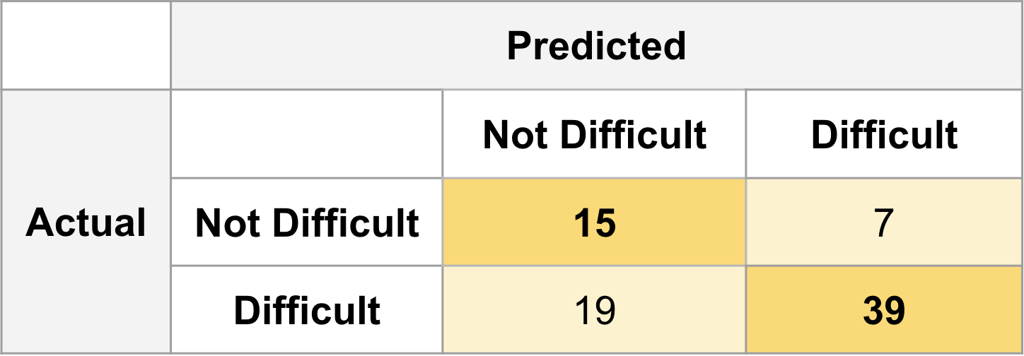
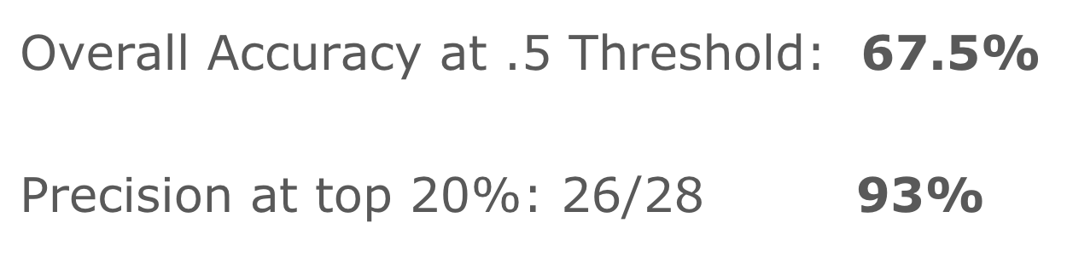
Model Evaluation
Goal
Datasets
Overall Confusion Matrix on Test Set
Workflow
Model
Results
Chrome
Plugin
Website
Summary
Notes:
We evaluated our complexity model by manually tagging 80 random Wikipedia articles for their difficulty level and then comparing it to the model results. We found that we had an accuracy of 67.5% with a threshold of 0.5 and an precision of 93% when looking at the top 20%. So at the edges, it does quite well.

Slide 11
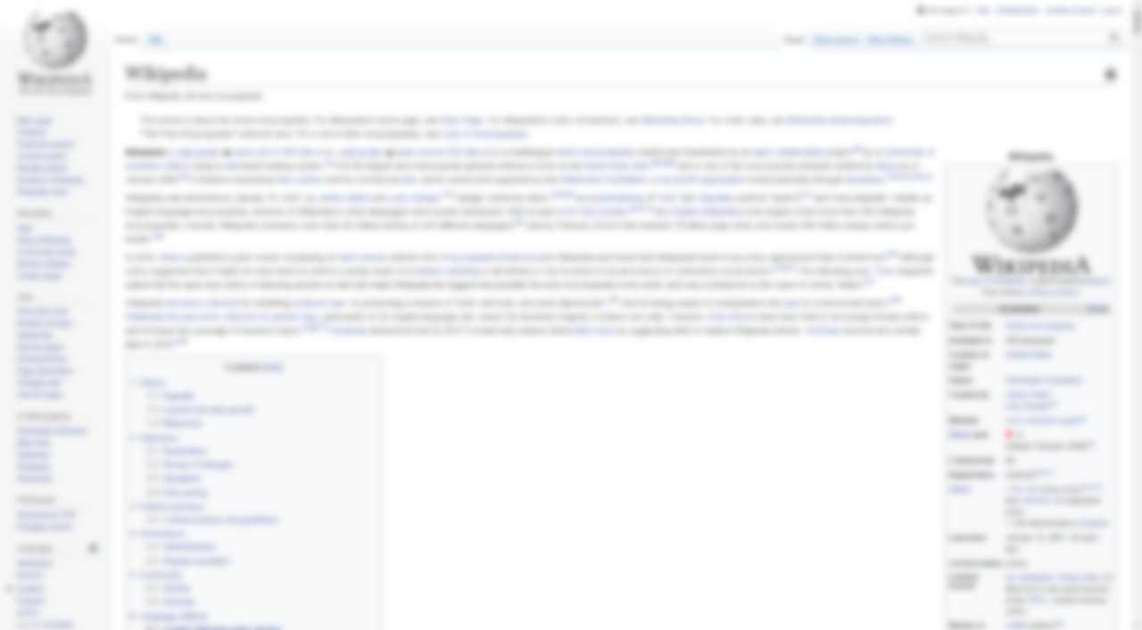
Motivation
Motivation
Results
Notes:
We put our results into a plugin which we can show in real-time if you want, but adriena will show an overview through screenshots.

Slide 12
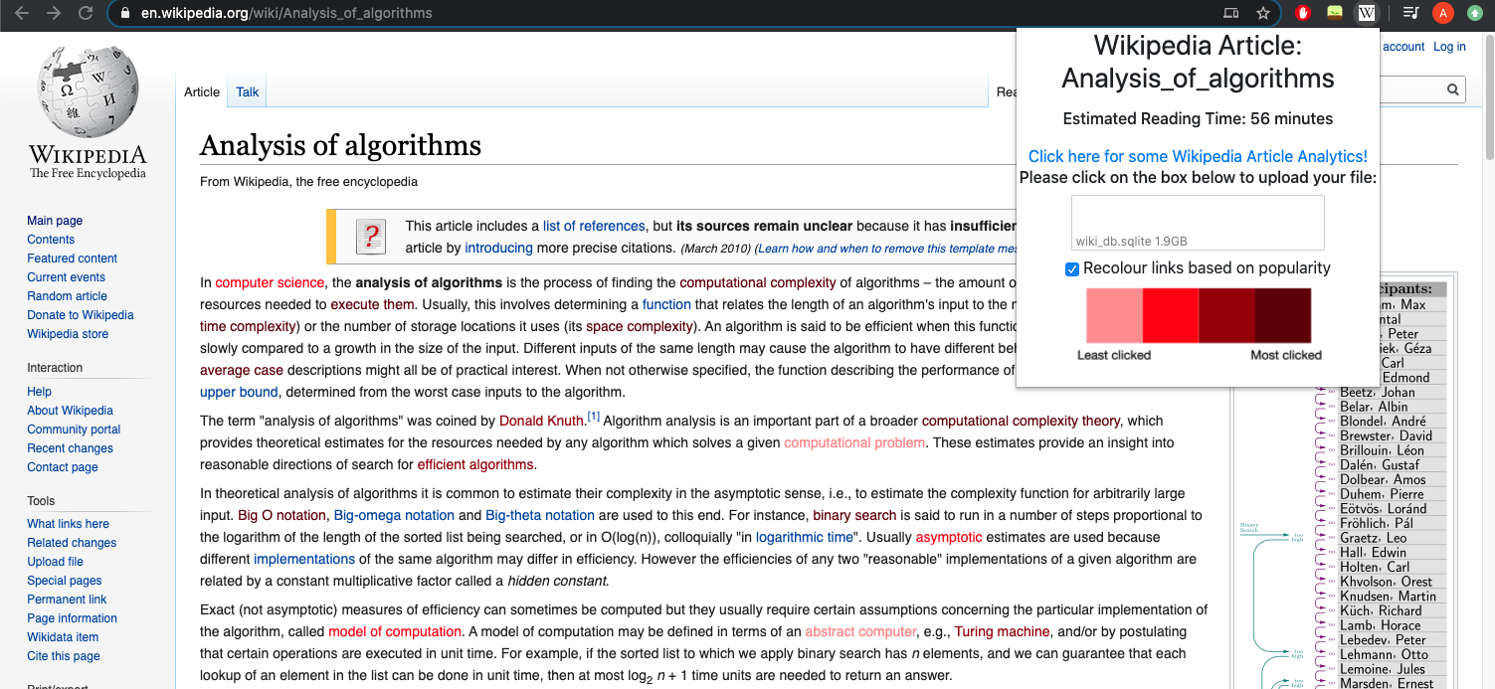
WikiPlugin API Chrome Extension
Goal
Datasets
Workflow
Model
Results
Chrome
Plugin
Website
Summary
Notes:
This is a Chrome plugin where users can check a box to highlight the links on the page according to relevance. It also displays each article’s read-time estimate by using article length multiplied by the difficulty probability as calculated by our model. The plugin also includes a hyperlink to our Flask webpage...

Slide 13
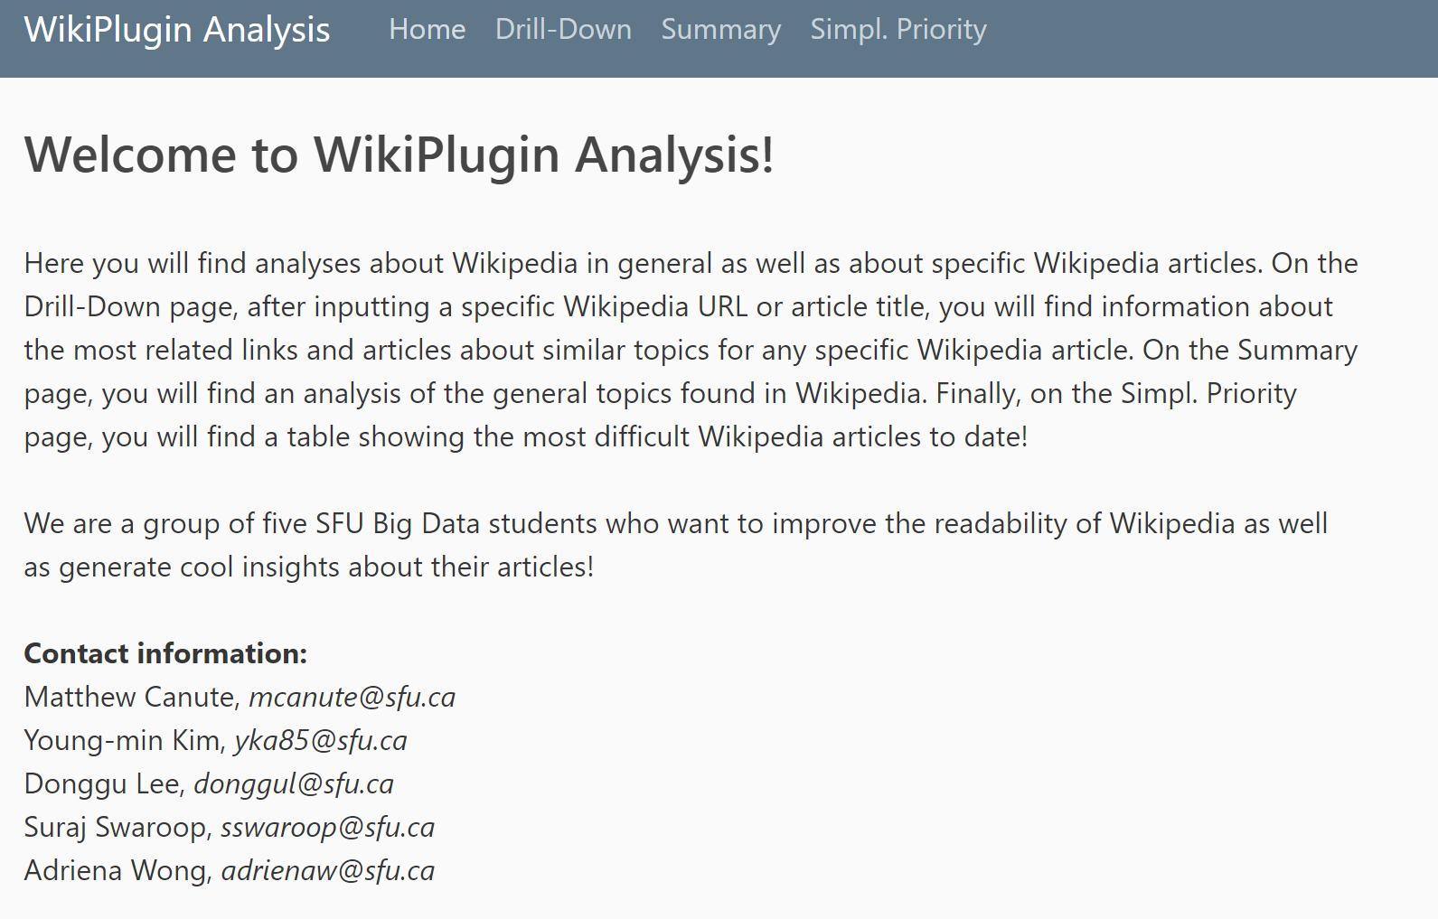
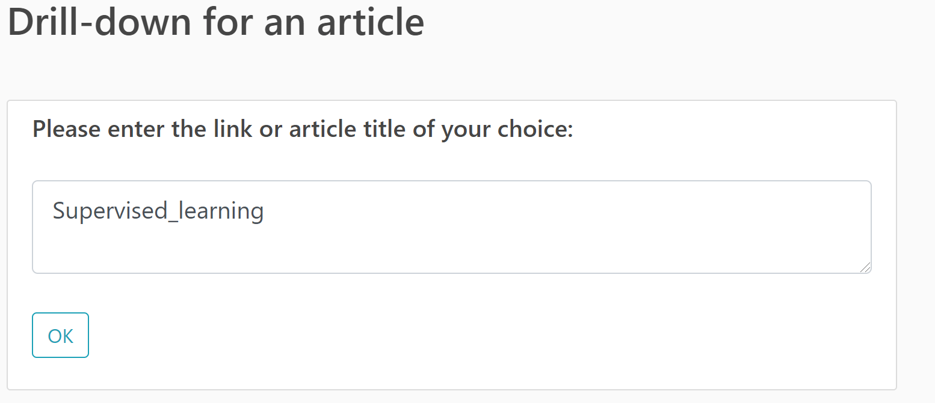
WikiPlugin Web
Goal
Main Page
Input Page
Datasets
Workflow
Model
Results
Chrome
Plugin
Website
Summary
Notes:
that looks like this. We can look at a particular article as well as general Wikipedia statistics. If we input the article ‘Supervised_learning’ ...

Slide 14
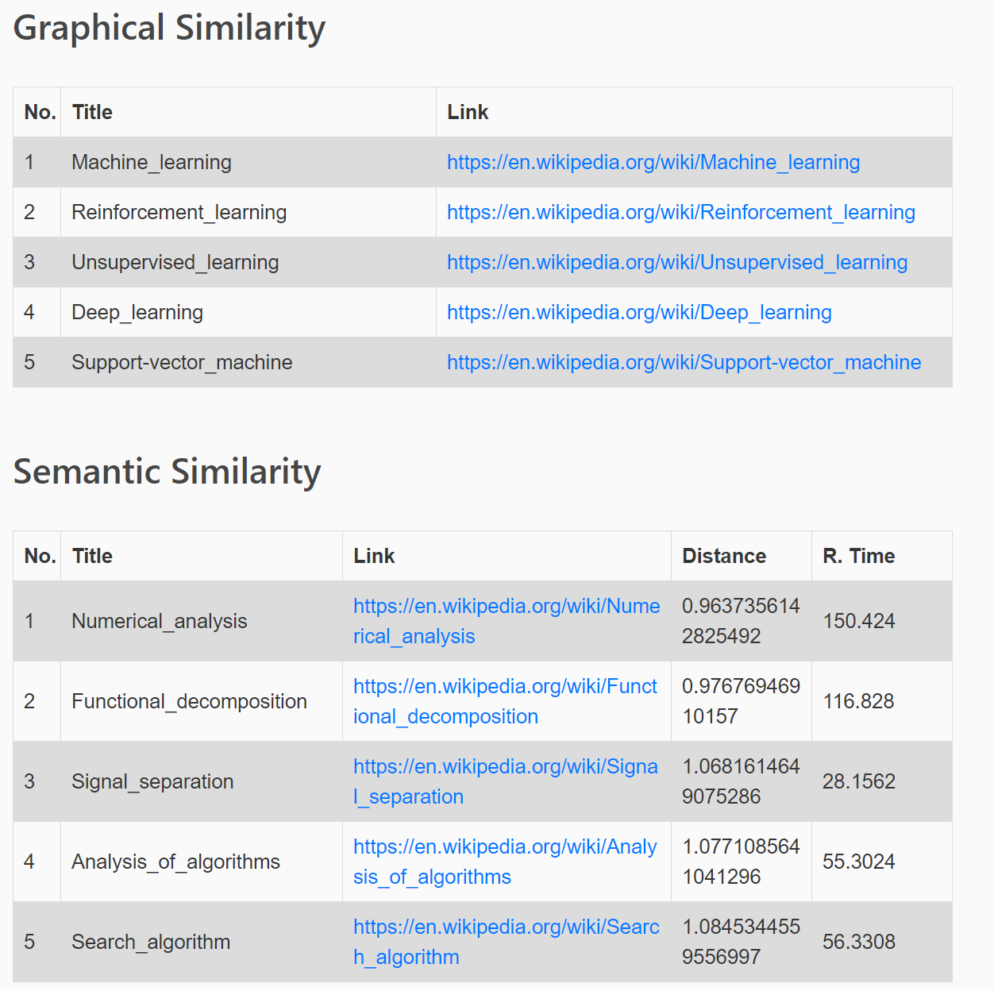
WikiPlugin Web
Goal
Summary Page #1
Datasets
Workflow
Model
Results
Chrome
Plugin
Website
Summary
Notes:
Then we can see the most similar articles based on the underlying graphical metrics
as well as the most semantically similar articles based on the article text.

Slide 15
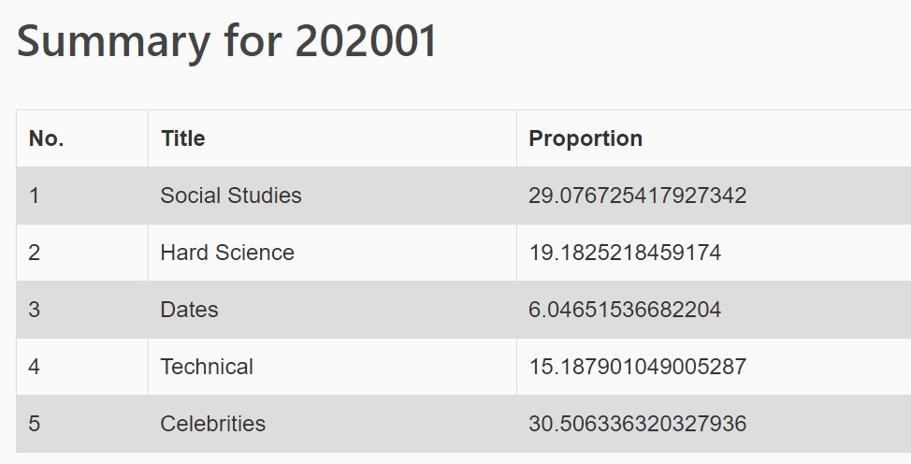
WikiPlugin Web
Goal
Summary Page #2
Datasets
Workflow
Model
Results
Chrome
Plugin
Website
Summary
Notes:
We also can see trends over time for each month, this is a topic breakdown of the wikipedia articles for January.

Slide 16
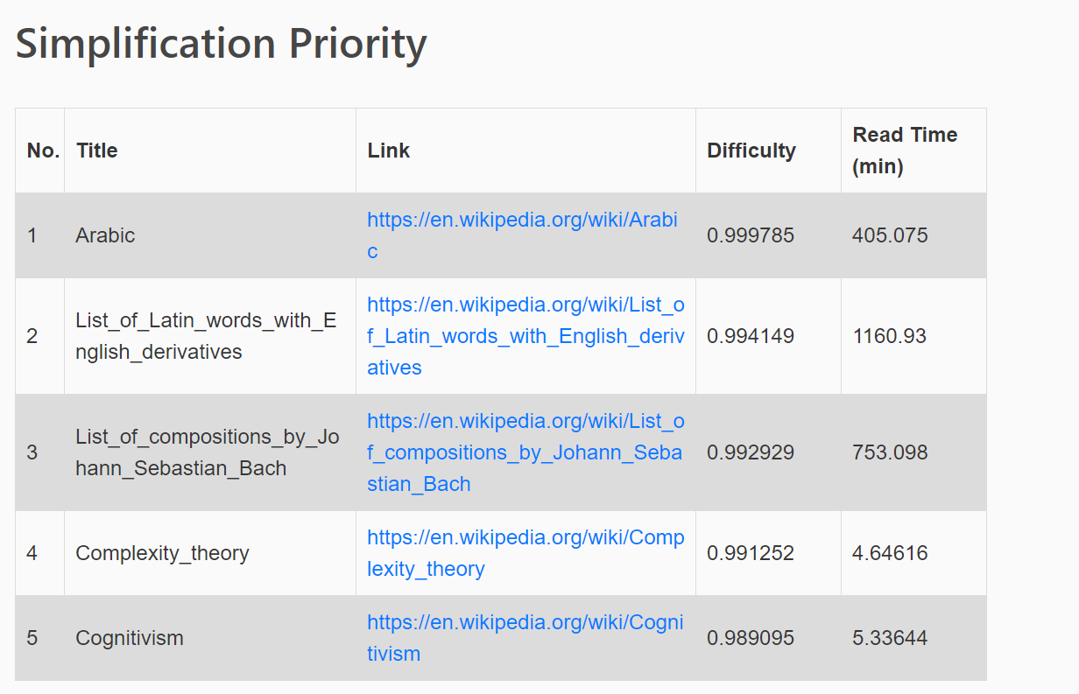
WikiPlugin Web
Goal
Summary Page #3
Datasets
Workflow
Model
Results
Chrome
Plugin
Website
Summary
Notes:
Then we also have a simplification priority queue.
We can take the highest expected difficult articles from the set of articles that don’t already have a simplified page today.

Slide 17
Summary
Goal
Datasets
Innovation
Novel approach using both graphical and textual datasets to:
Build a model to assess concept difficulty
Compare the similarity results between graphical/semantic
Workflow
Model
Results
Chrome
Plugin
Website
Summary
Notes:
In summary, we used the publicly available Wikipedia datasets to derive insights about article difficulty in ways that haven’t been largely explored previously.
Making use of both the graphical and text data, we are able to build a model with a feature-derived dataset for predicting the difficulty of a concept, and we can contrast the similarity metrics between the graphical versus the semantic approach.

Slide 18
Summary
Goal
Datasets
Innovation
Novel approach using both graphical and textual datasets to:
Build a model to assess concept difficulty
Compare the similarity results between graphical/semantic
Potential Impact
Could solve problem of overlapping work in different fields
Simple Wikipedia improvement
Workflow
Model
Results
Chrome
Plugin
Website
Summary
Notes:
Comparing these two approaches could help researchers to determine cross-disciplinary similar goals.
There are similar goals that different disciplines are trying to achieve, and they may not be aware of that-- this tool could show some of those cases by showing semantically similar articles that aren’t at all linked graphically (by links)
e.g., biologists rediscovering the riemanns sums
PLUS, THE PRIORITY QUEUE paves the way for a bounty system for choosing which articles are included in Simple Wikipedia that’s better than a crude voting system

Slide 19
Summary
Goal
Datasets
Innovation
Novel approach using both graphical and textual datasets to:
Build a model to assess concept difficulty
Compare the similarity results between graphical/semantic
Potential Impact
Could solve problem of overlapping work in different fields
Simple Wikipedia improvement
Implementation
Docker Container for pipeline / front-end -- cloud storage
Workflow
Model
Results
Chrome
Plugin
Website
Summary
Notes:
In terms of designing this project to be able to be done by multiple people, the tasks are also well separated so any part can be easily maintained and updated if necessary.
Steps to download all the necessary datasets, and to run the extension and Flask webpage are well documented in our gitlab repo. Jenkins pipeline makes it easy to reproduce our model.

Slide 20












Component Design
Goal
Datasets
Workflow
USER
VIEW (Web)
VIEW
(Chrome Extension)
Model
Results
Chrome
Plugin
Website
MODEL
Monthly
DB
CLOUD
Summary
Docker
Minion
Minion
Jenkins
Minion
Notes:
Here is the general structure of our project including some of the tools we used.
22 sec

Slide 21
Contact Information
Professional Master’s in Big Data Computing Science
Matthew Canute - mcanute@sfu.ca
Young-min Kim - yka85@sfu.ca
Donggu Lee - donggul@sfu.ca
Suraj Swaroop - sswaroop@sfu.ca
Adriena Wong - adrienaw@sfu.ca
Homepage of the WikiPlugin demo: http://172.105.25.92/
Notes:
Here is our contact info

Slide 22
Thank you
Professional Master’s in Big Data Computing Science
Notes:
We’d like to thank you for listening and we’re open to any questions!

Slide 23
Q & A
Notes:
POTENTIAL QUESTIONS THEY COULD ASK:
whats up with the extension… how can you make it more user-friendly
-> we can indeed. This was a minimum viable product please stand by while we figure out how to convert the google extension over to a pubsub model like so:
Who do you think use this app/model/web? What is your main target when you developed this model?
Since Wikipedia is open web(Free), there is no way to gain profit from Wikipedia. Have you thought about applying this model to earn/make a profit by deploying this model to other industry/application/companies/?
Why do we need to insert a sqlite file in the plugin and not directly read from the database?
How did we determine that an article that was used for training our difficulty model was easy/normal/difficult?
-> All the 300 articles were ranked by each of us and we labelled the article based on majority
What was the most challenging part in this project?

Slide 24
Motivation
Motivation
Appendix

Slide 25
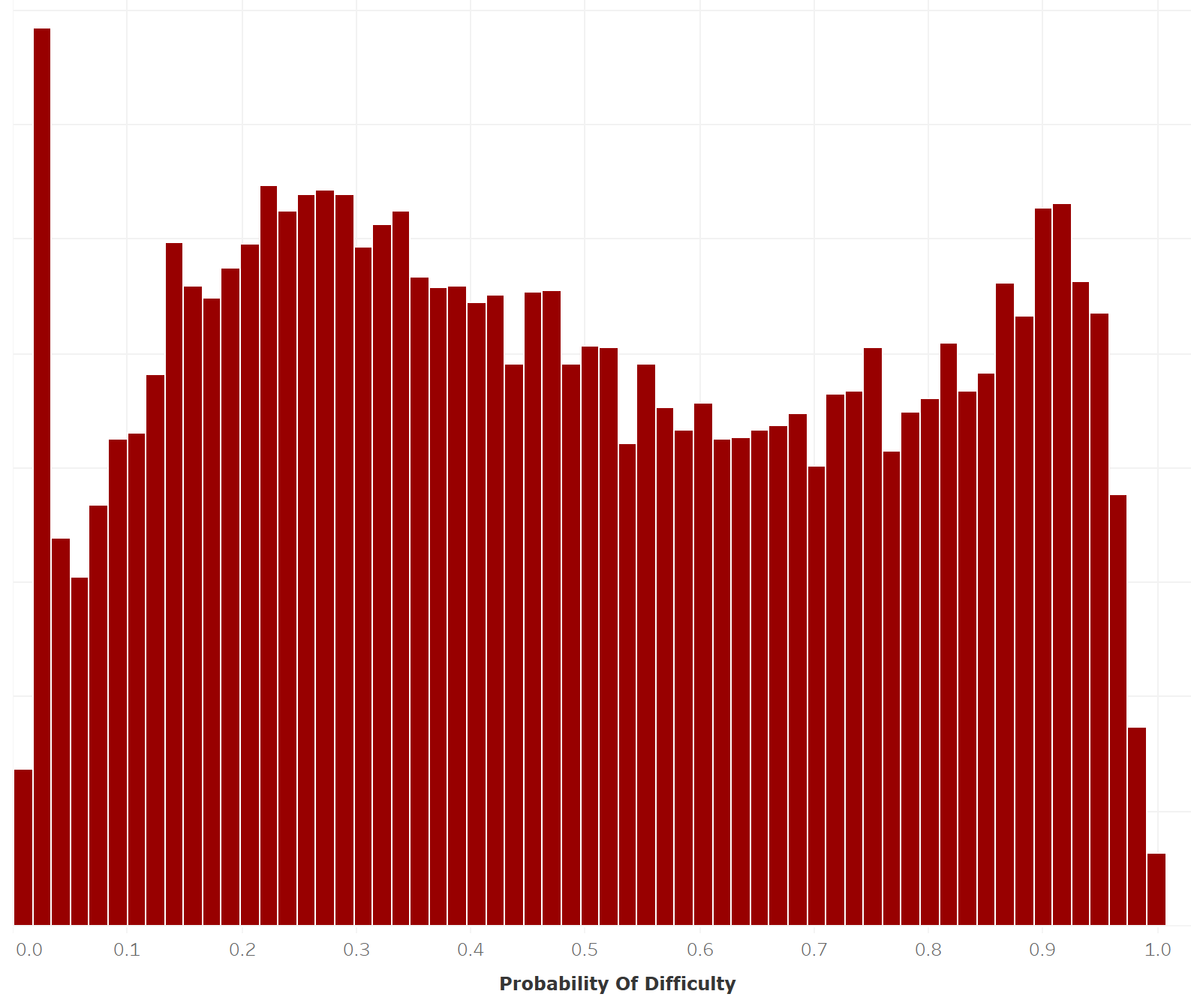
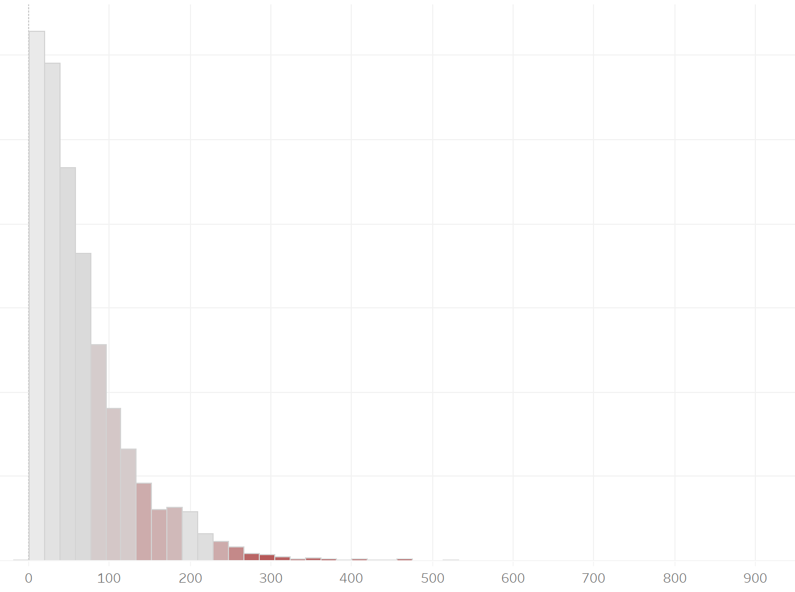

High Level Analysis
Goal
Model’s Prediction Probability Distribution
Adjusted Read Time (Minutes) Distribution
Datasets
Workflow
Model
Results
Chrome
Plugin
Website
Summary
Probability of being ‘difficult’
Median Probability Prediction Gradient
Notes:
If this model is representative, wikipedia seems to have a bimodal distribution of difficult articles, and simple articles.
That peak is the set of all “disambiguation” articles.
There is a correlation between our adjusted read time (of course since we use the (probability distribution + 1) as a multiplier of the standard number of words / 225 minutes calculation.
30 sec

Slide 26
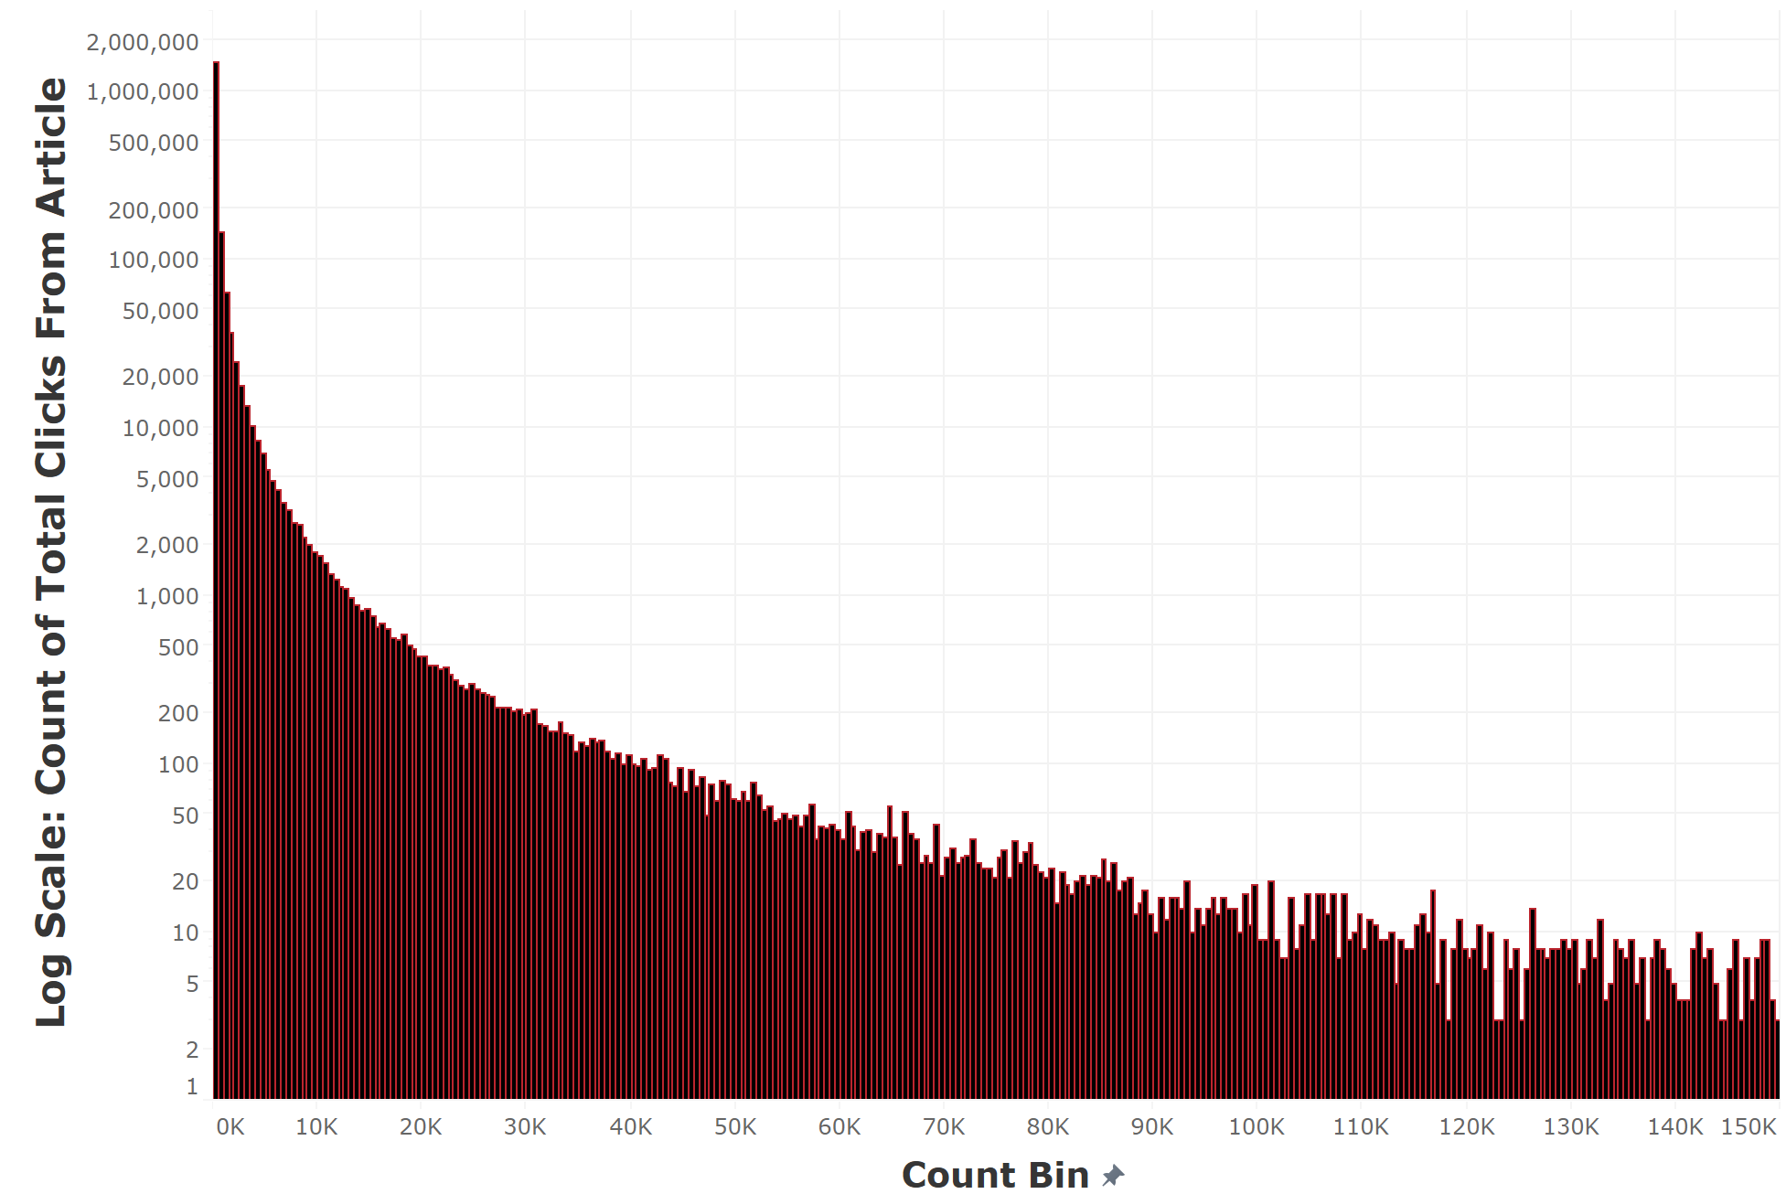
High Level Analysis
Distribution of “Origin Articles” Click Volume
Goal
Datasets
Workflow
Design
Model
Results
Chrome
Plugin
Website
Notes:
If this model is representative, wikipedia seems to have a bimodal distribution of difficult articles, and simple articles.
That peak is the set of all “disambiguation” articles.
There is a correlation between our adjusted read time (of course since we use the (probability distribution + 1) as a multiplier of the standard number of words / 225 minutes calculation.

Slide 27
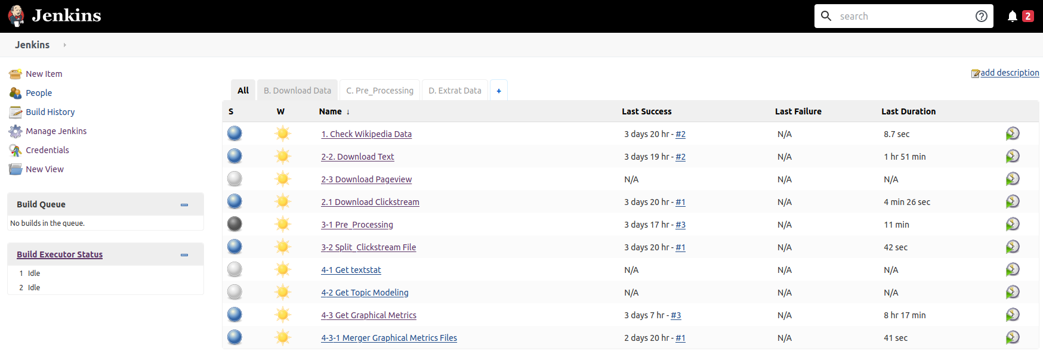
Workflow
ETL Pipeline (Jenkins + Docker)
Notes:
Here is our Jenkins pipeline to be run monthly

Slide 28
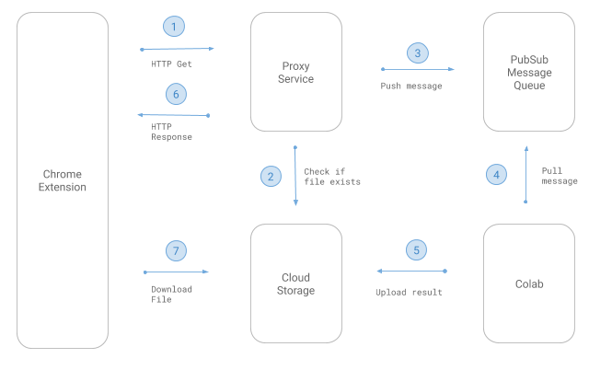
Potential Future Architecture
Notes:
Here is our Jenkins pipeline to be run monthly

Slide 29
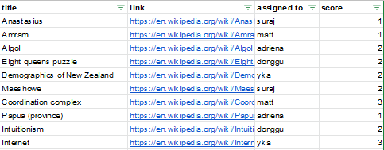
Our ‘Difficulty’ Model
Training Dataset
Notes:
Here is an sample of the self-labelled articles.

Slide 30
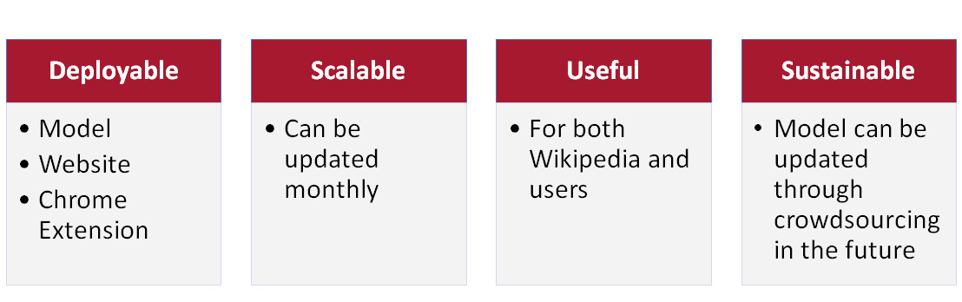
Our Solution
Notes:
Why is your solution good? Why does your result make sense?
Good in many senses of the word:
Deployable: Our solution is a deployed model, a website, a chrome extension. It is ready to go. We can deploy it if we want to.
Scalable: We’re able to do this for all of the clickstream of wikipedia right now. We can update it for next month. Why not?
Useful: Haven’t you always wanted a smart tutor that could guide you along a page. Haven’t you been frustrated at clicking on a page for a hard science concept, and being immediately launched into complicated vector calculus to explain a something that could be explained by an analogy first, or could at least point you in the direction of the links you’d need to read first? We have approximately moved towards that goal, and in my opinion, using it to read wikipedia, it honestly makes the experience better. I know that I’m going to be using it for my own purposes. And so should you.
Sustainable: It’s possible that we could update this later on to incorporate feedback, if there are many users, we could crowdsource their answers as for what’s a complicated page, and what’s not a complicated page.

Slide 31
What we have learned from this project
Javascript
Jenkins / Docker
Hosting MySQL on a cloud storage database
Deploying a model into a Google Chrome extension
Building a Google Chrome extension
Notes:
What have you learned through the project?
Friendship. Javascript. Jenkins. Flask. Docker. Hosting MySQL on a cloud storage database. Deploying a model into a google chrome extension.
Maybe add some WIkipedia findings that we found interesting :)

Slide 32
Possible Model Improvements
Experiment
Experimenting with larger range of difficulty when tagging articles
Dataset
Larger labelled dataset
Taking Average
Taking average of labels from multiple taggers in the training set
Online-Learning
Using an online-learning approach to tag articles that the model is “uncertain” (.5 scores).
Notes:
Obviously more data
Larger range of labels.
Online learning.
5:08
Next steps.
Some ways we can potentially improve our trained model is by experimenting with a larger difficulty range when manually tagging articles. Currently, we had a scale from 1 to 3 but we could try a larger scale such as from 1 to 5.
Also, if given more time, we could also increase the training set by manually tagging more articles.
We could also have multiple people tag the same articles and take the average of the results
Finally, we can use an online-learning approach for articles where the difficulty score was uncertain

Slide 33
What else can be done?
1
2
Web Domain
Buying a web domain, and deploying it onto there
Crowdsourcing Techniques
Creating a data input source from the plugin for users to improve the quality of our dataset for the model
Notes:
We want to deploy it on a web domain with a specific domain name, which we have on an ip address right now
Let’s create a data input mechanism for others to put data into through crowdsourcing.
5:23

Slide 34
Tools We Used
Goal
Python Library
Datasets
Workflow
Tools
Model
Results
Chrome
Plugin
Website
Web / Chrome Extension
Database / Cloud
Notes:
What datasets/tools did you use?
Tools:
Docker
Jenkins
Flask/sklearn/gensim/numpy/pandas
Google Chrome Extensions / Javascript
MySQL (Google Cloud)
Python Libraries - Gensim, NLTK, TextStat, NetworkX
Simple Wikipedia API

Slide 35
Component Design
Goal
MODEL: Python Library
Datasets
USER
VIEW
Workflow
Design
Model
Results
Chrome
Plugin
MODEL
DATABASE
VIEW
Website
DATABASE
Notes:
What datasets/tools did you use?
Tools:
Docker
Jenkins
Flask/sklearn/gensim/numpy/pandas
Google Chrome Extensions / Javascript
MySQL (Google Cloud)
Python Libraries - Gensim, NLTK, TextStat, NetworkX
Simple Wikipedia API

